Slide 1
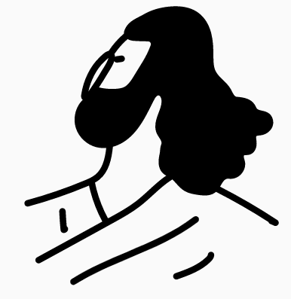



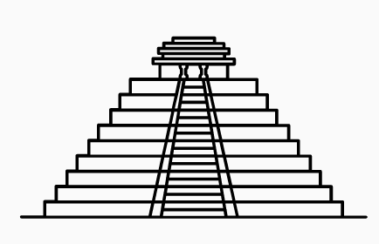











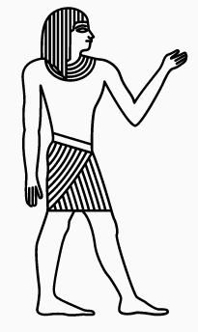







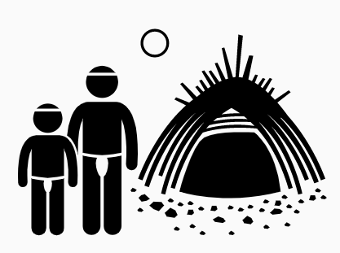








Gunthorpe CofE Primary- History
Greek influence on the western world
King K’nich Janaab Pakal
KEY
Changes within living memory
Changes beyond Living memory
Significant Individuals through history
Significant events/people in own locality
Study of Mayan life
Study of Greek life and achievements
Mayans
Ancient Greece
The Olympics
Evidence of remains of Ancient Maya
Technology and tools development
Archduke Franz Ferdinand
Life in Nottingham during the war
Blitz
Battle of Britain
Holocaust
Hill forts
WW1
Stone age to Iron Age
The Great War
Propaganda
World War Two
Adolf Hitler
Winston Churchill
Stonehenge
Changes in Britain from Stone age to Iron age
British trenches
Anglo-Saxon arrival and settlements
The space race
What’s out there?
Vikings
Changes in social history
Timeline of change
Famous Egyptians
Why do we speak English?
Where did English come from?
Junior 2
Law and order
Year 5/6
Neil Armstrong
Roman Empire
Famous Romans
Know why rules and law changed beyond 1066
Incredible Egyptians
Achievements of Egyptians
Life as an Egyptian
Timeline of expedition
Junior 1
Sir Robert Falcon Scott
Year 3/4
On the move
Australia
The Big Freeze
Time line of transport
Aboriginal civilisation
Gunthorpe now and in the past
Compare and contrast nursing conditions now and in the past
My
Village
and
me
Life of Mary Seacole
Life of Samuel Pepys
Comparing Victorian and modern school
Mary Seacole
The Great Fire of London
Victorians
Seaside
Knowing
Me
Knowing
you
Time lines and family trees
Timeline of events of the fire
Comparing holidays now and in the past
Wright Brothers
Sequencing Time lines
Remember and talks about significant events in their own life
Infant 2
Where in the World
Time for a change
Light
Wonderful Me
Infant 1
YEAR 1/2
EYFS
Van Gogh
Benjamin Franklin
ELG: U the W -Talk about the lives of people around them and their roles in society.
Know some similarities and differences between things in the past and now, drawing on their experiences and what has been read in class.
Understand the past through settings, characters and events encountered in books read in class and storytelling.
TOUCHING HEARTS, FEEDING MINDS

